Slide 1

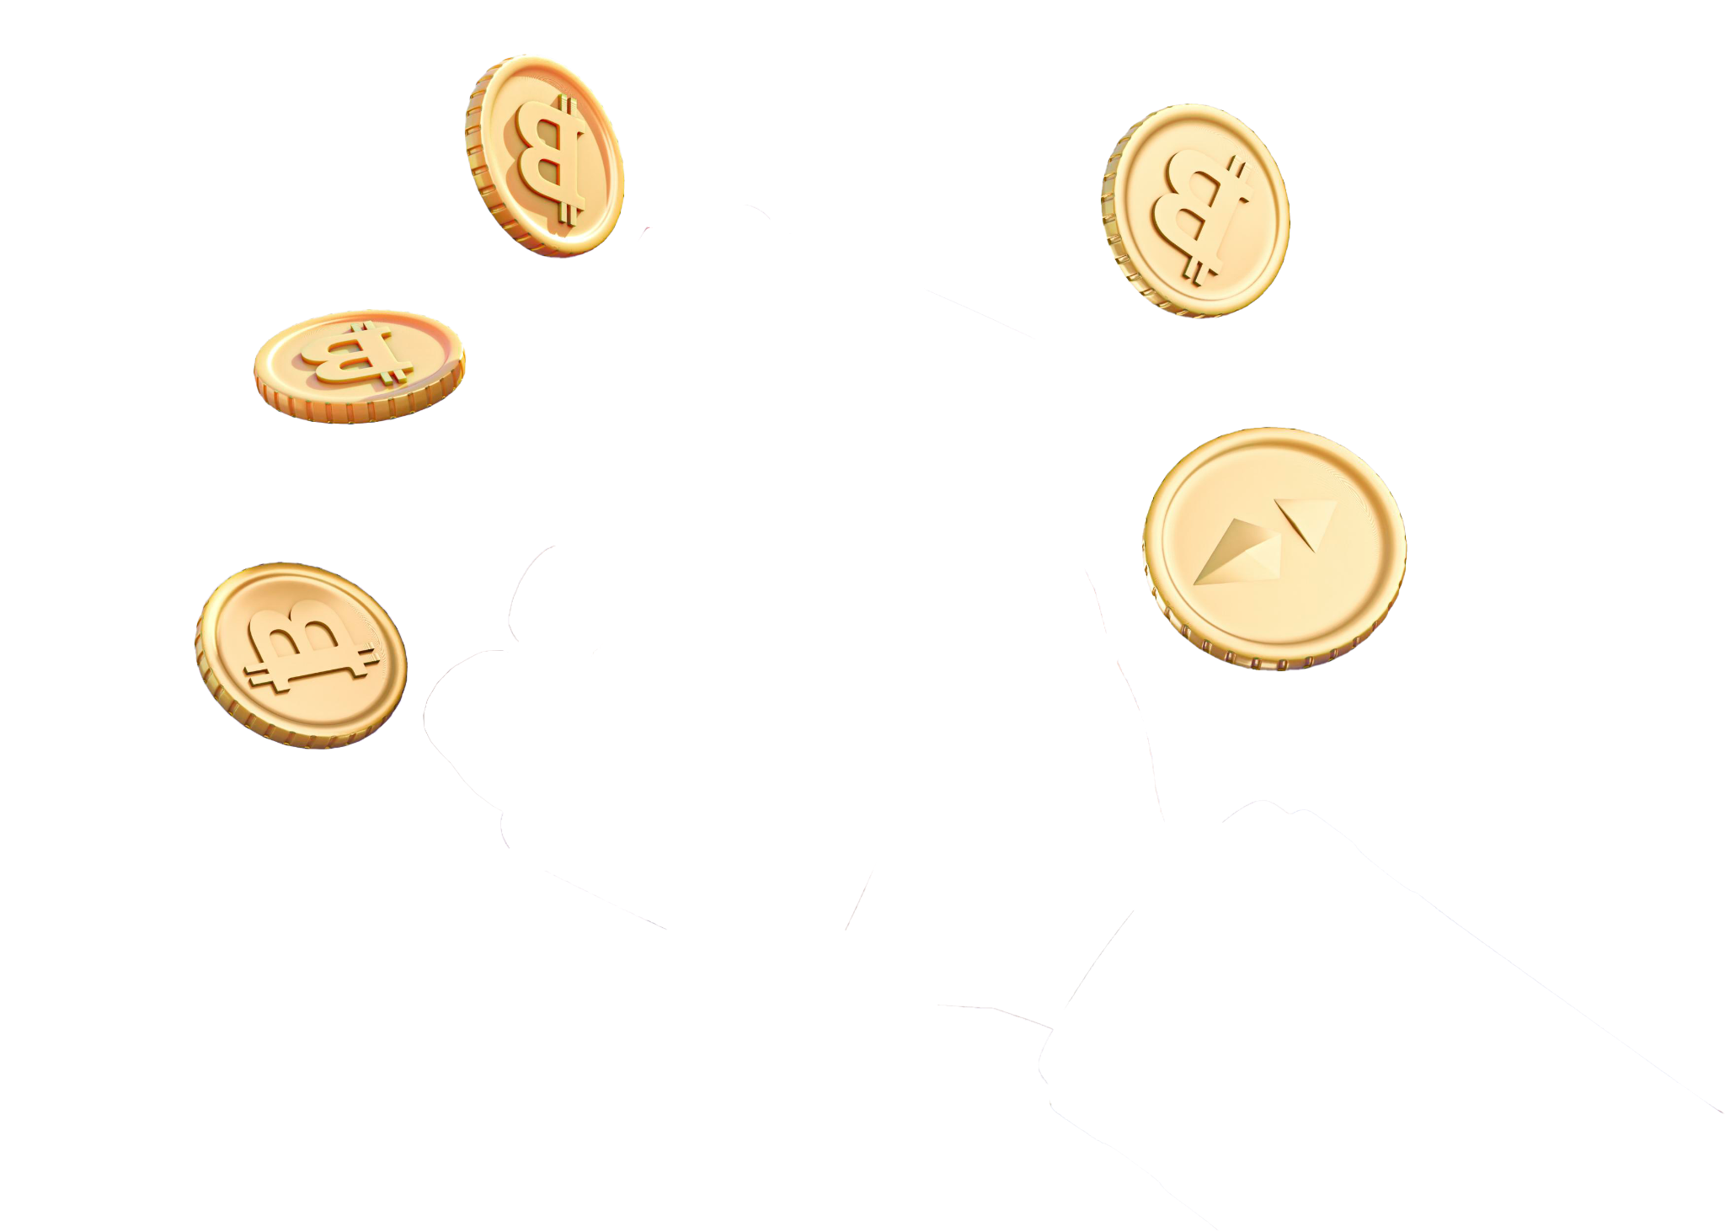
Bitcoin Price Prediction using Tweets
BY:
Pahwa Ronak
Arif Yusaf Ansari
Anand Pramod Aditya

Slide 2
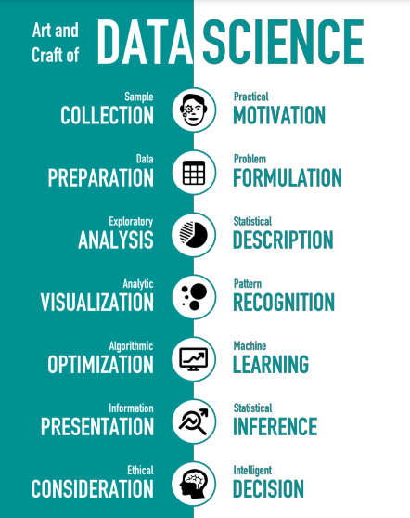

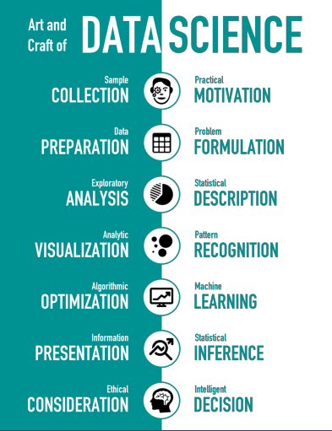
02
04

Slide 3
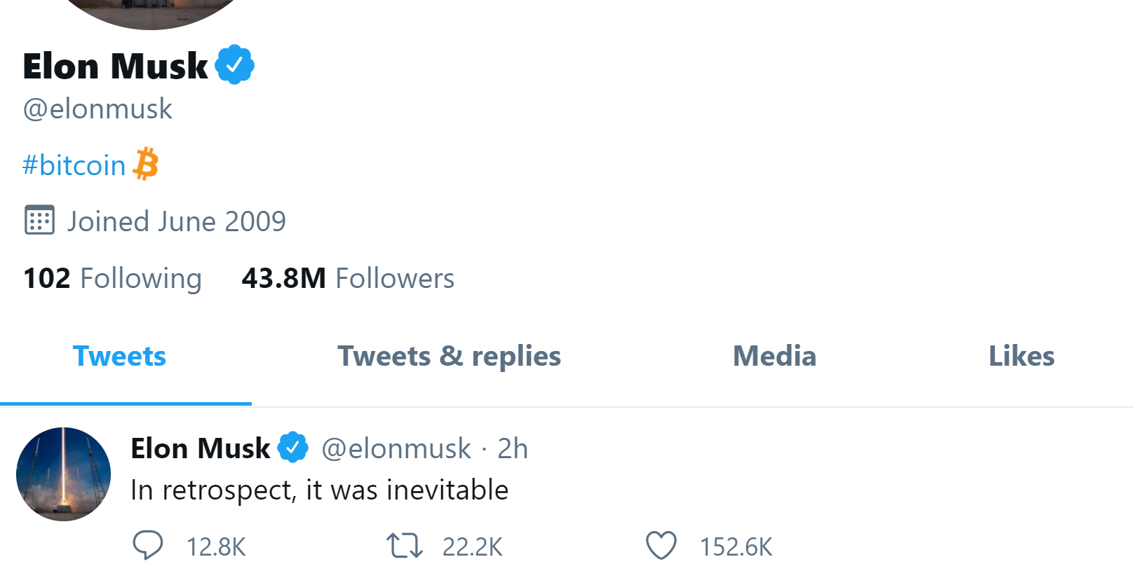
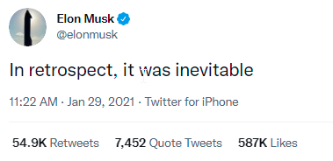
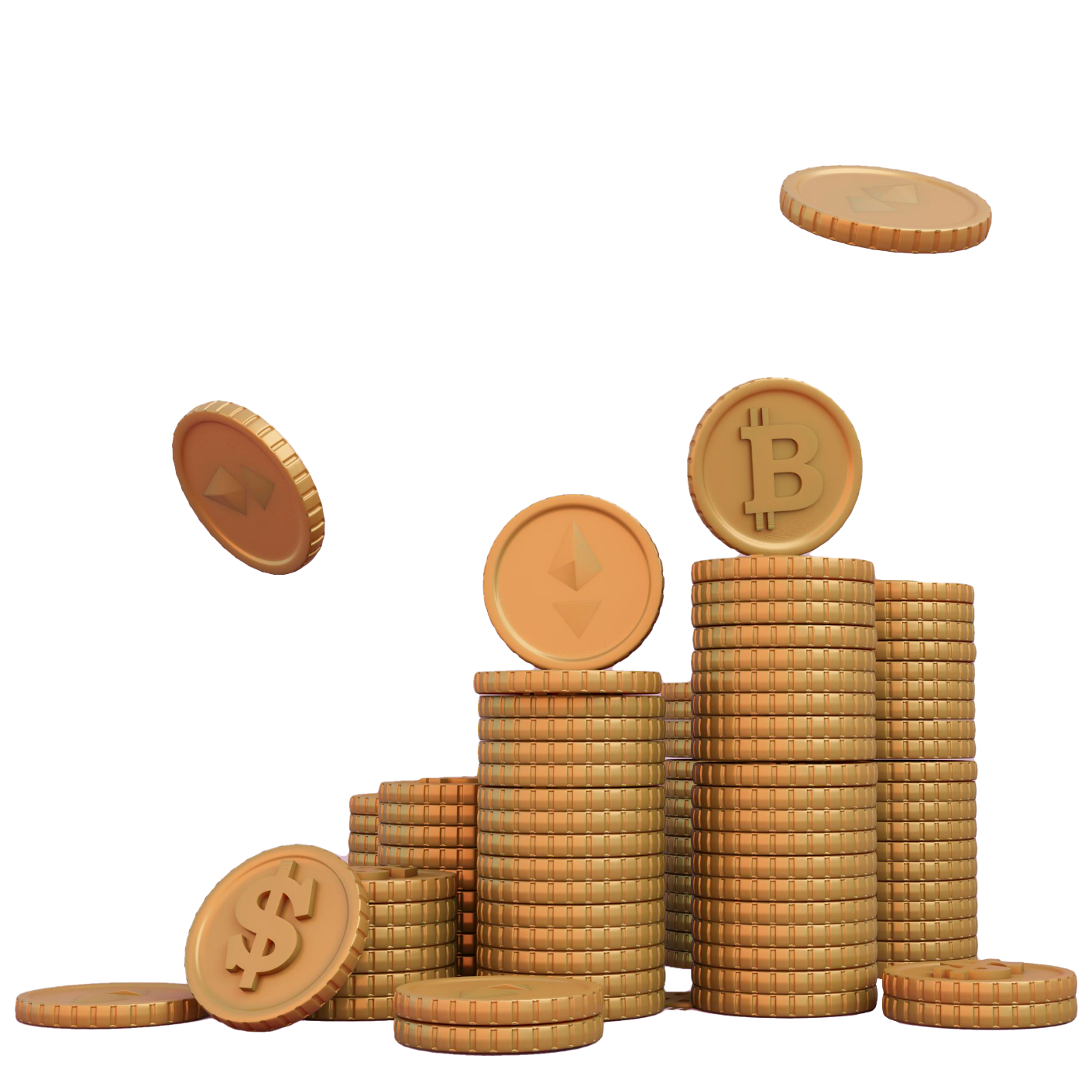
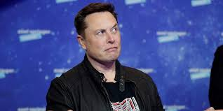
THE ELON MUSK TWEET
#Bitcoin
#Bitcoin
#Bitcoin

Slide 4


MOTIVATION
#Bitcoin
Real Life Challenge:
Tweets by high-profile figures can significantly impact the price of Bitcoin and other cryptocurrencies. → Challenging for investors to make informed decisions
Goal:
Allow investors and traders to make more informed decisions about when to buy and sell Bitcoin based on social media sentiment.
‘TWITTERVERSE’

Slide 5
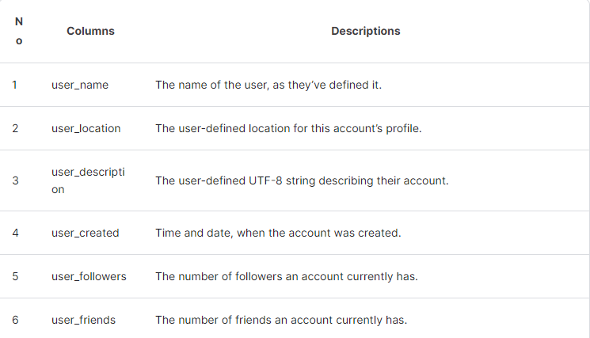
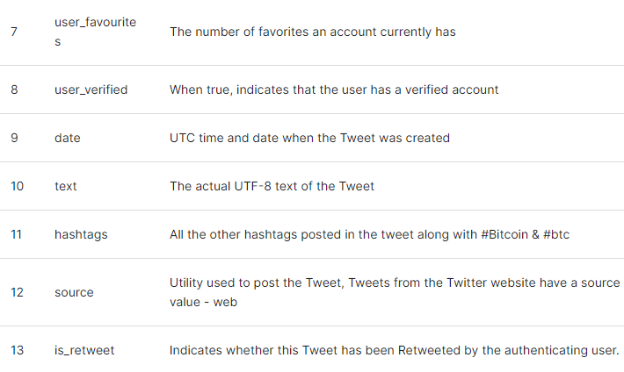
Our Dataset
Kaggle dataset - Bitcoin Tweets

Slide 6
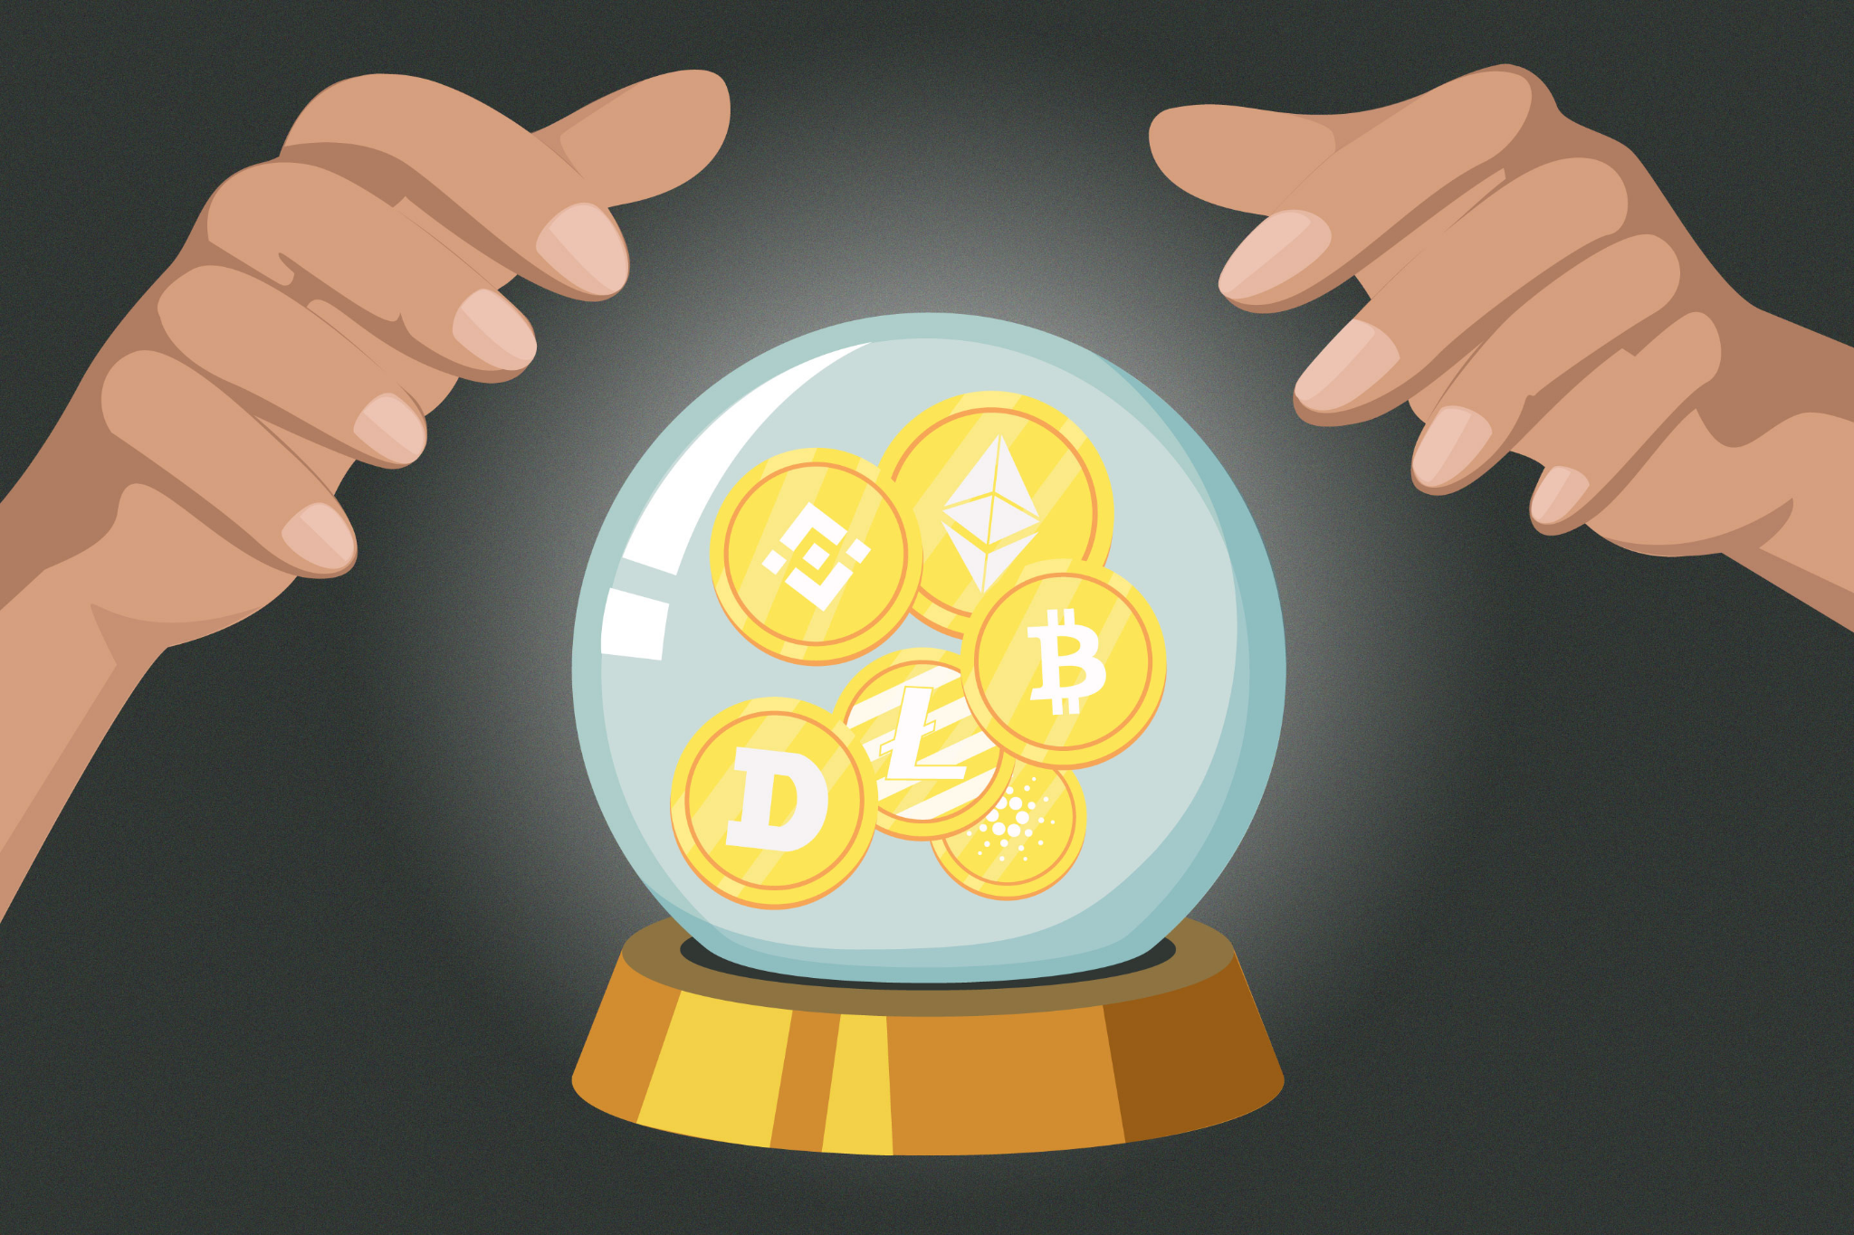
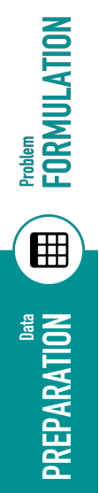
PRICE PREDICTION FOR INVESTORS

Slide 7
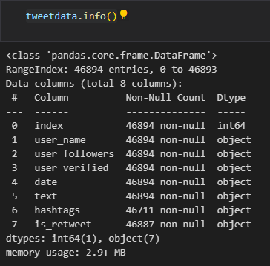
CLEANING THE DATASET
- Removing Certain columns-
user_location
user_description
user_created
user_friends
user_favourites
Source
-Clean ‘user_name’ → not supposed to have NULL values
-Shrinking the data for easier analysis

Slide 8
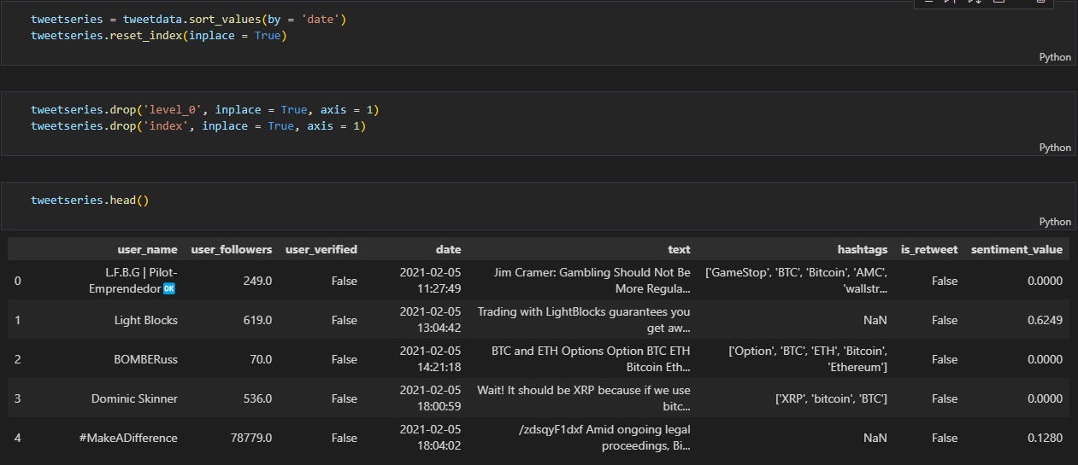
Sorting Dataset by ‘date’ → Bitcoin Price Over Time

Slide 9
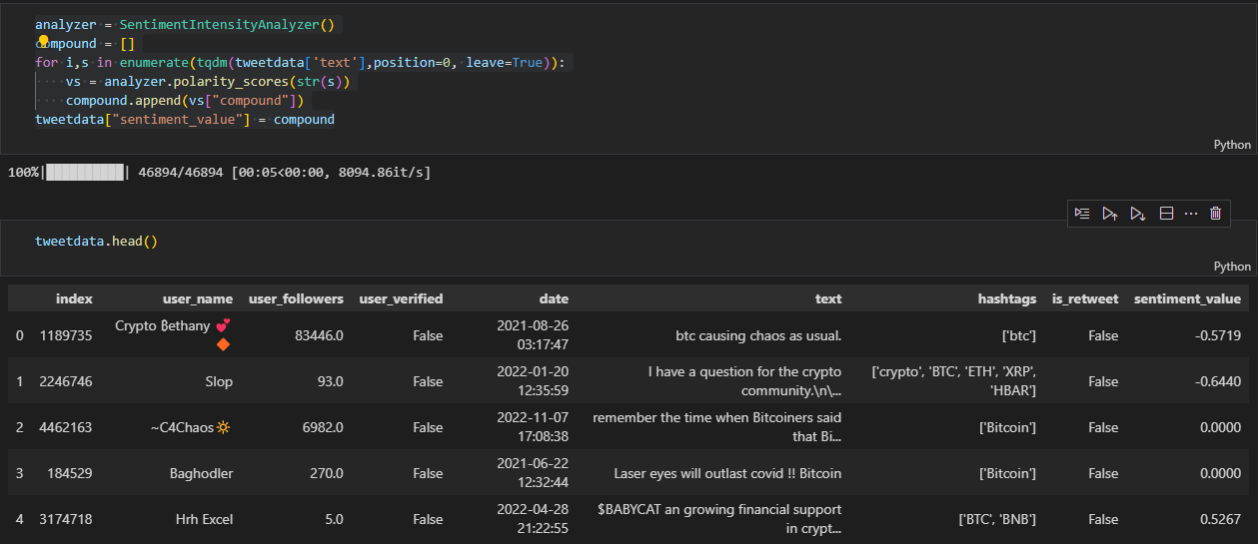

SENTIMENT ANALYSIS USING VADER

Slide 10
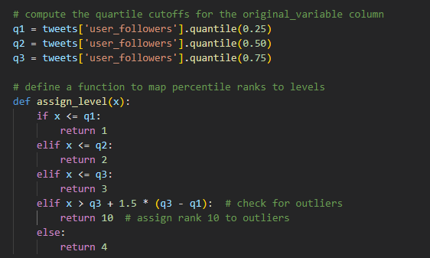
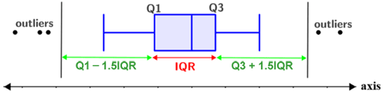
UPPER LIMIT:
Q3 + 1.5 * (Q3 - Q1)

Slide 11
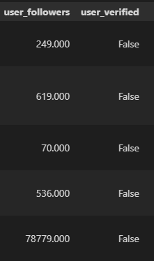
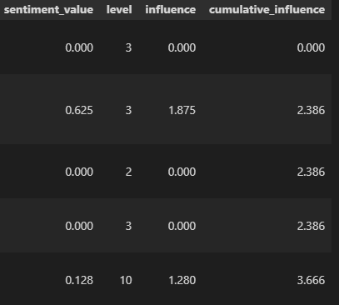
CALCULATING CUMULATIVE INFLUENCE BASED ON USER_FOLLOWERS

Slide 12

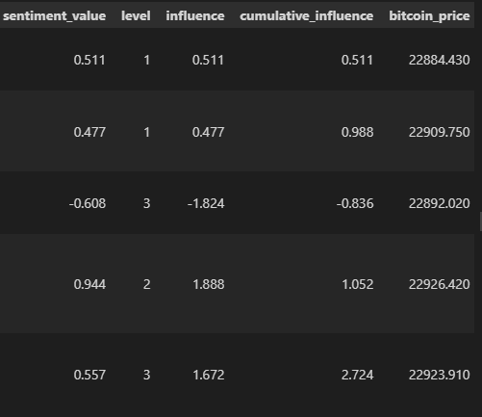
INTRODUCING THE PRICE DATASET
BITCOIN PRICE DATASET
COINBASE PRO API

Slide 13
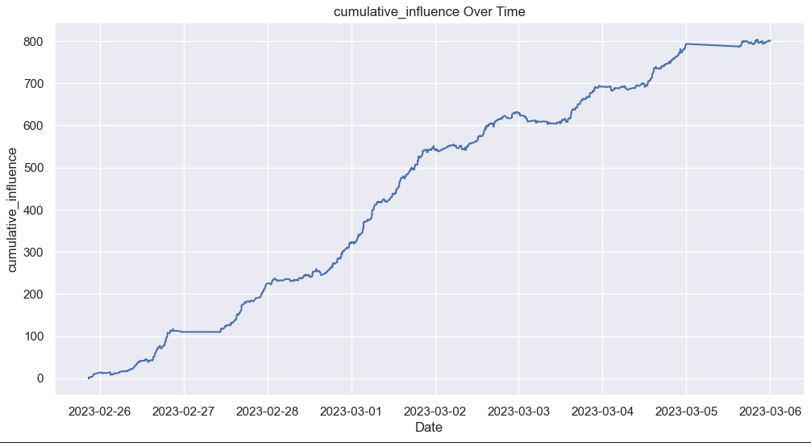

Your logo

Slide 14
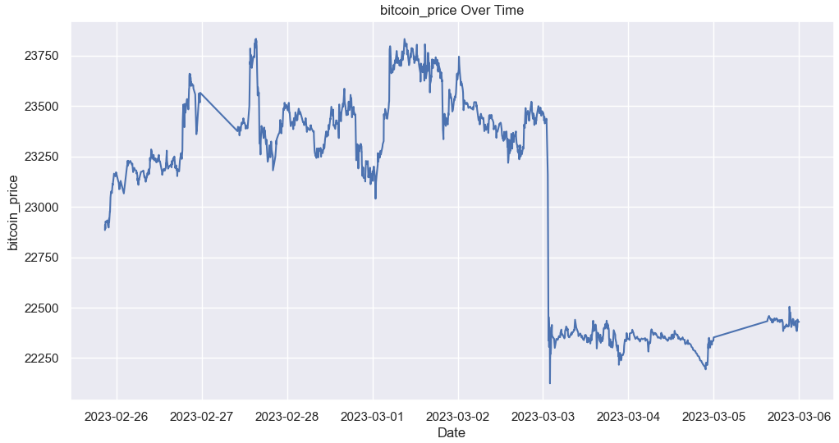
Your logo

Slide 15
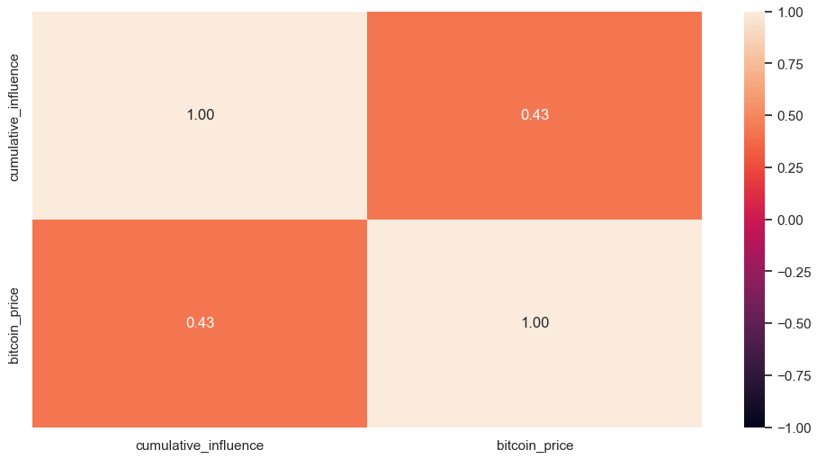
HEATMAP OF CORRELATION
Your logo

Slide 16
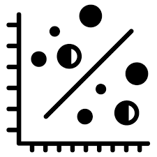

THE LINEAR REGRESSION MODEL
We split the dataset into training and testing sets and performed linear regression on the sentiment scores to predict the Bitcoin price.
Mean Squared Error (MSE), and R-squared to evaluate the model's performance.

Slide 17
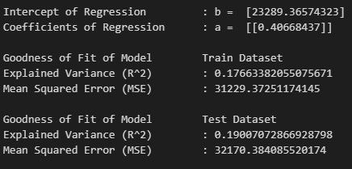
THE LINEAR REGRESSION MODEL
RESULTS:

Slide 18
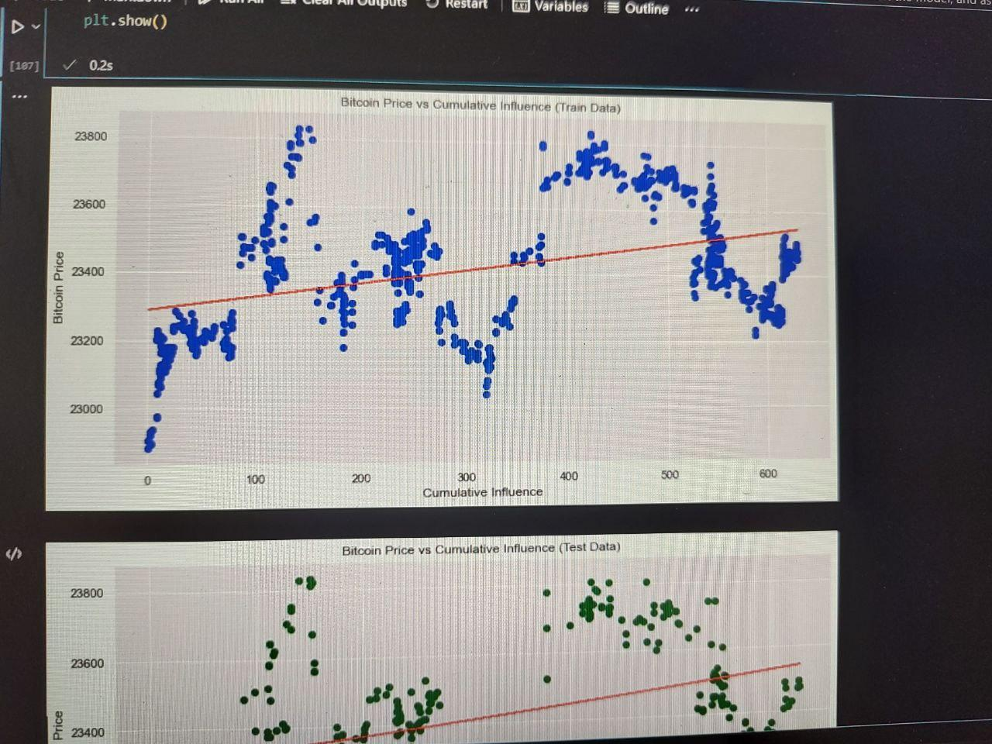
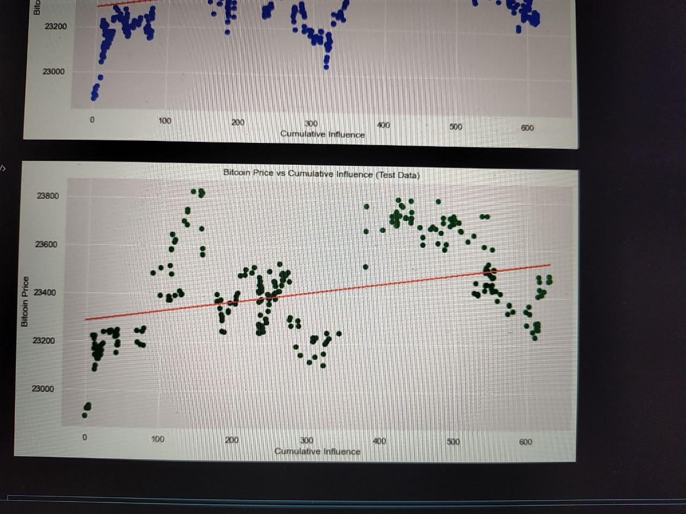

THE LINEAR REGRESSION MODEL
TRAIN DATASET
TEST DATASET

Slide 19
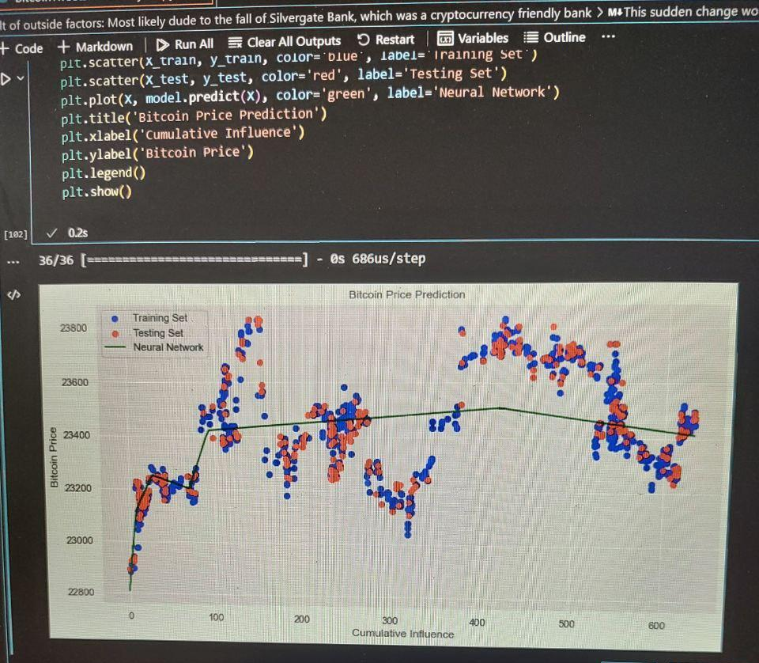
THE NETWORK MODEL
RESULTS:
Train MSE: 25370.3682
Test MSE: 28356.5196
Train MAE: 124.2720
Test MAE: 133.0506
Train R^2: 0.3165
Test R^2: 0.3270

Slide 20
CONCLUSION
WHY THIS MODEL?
MAIN OBJECTIVE
Demonstration of the potential relationship between sentiment scores and Bitcoin price and giving rough estimate of prediction, rather than a definitive prediction model.
ASSUMPTIONS -
We did not consider any influence from before our dataset starts
We interpolated a small amount of price values.
Social media influence is but one factor affecting the price of bitcoin.

Slide 21
References
https://www.kaggle.com/datasets/kaushiksuresh147/bitcoin-tweets
https://www.kaggle.com/code/erdeq1024/bitcoin-price-analysis-by-tweets
https://pypi.org/project/vaderSentiment/
https://pypi.org/project/cbpro/

